Slide 1
Traditional Text and Formatting
Deprecated and Obsolete Elements
Text Layout
Lists
Text Styles
The FONT and BASEFONT Elements

Slide 2
Deprecated and Obsolete Elements
As HTML evolves, the function of some elements is replaced or suppressed by newer.
Some are still fully functional and useful, but can be done more economically or efficiently.
For example, both the <IMG> and <APPLET> tags still work, but both perform similar tasks – embedding particular object in the HTML page.
A single <OBJECT> element would be designed that would encompass all possible embeddable objects.
Thus, both <IMG> and <APPLET> are now deprecated in favor of <OBJECT> tag.
When an element is deprecated, that means that the W3C recommends that you no longer use it, but use, the newer solution.

Slide 3
Deprecated and Obsolete Elements
However, deprecated elements are still a part of HTML specification, and still be supported by browsers.
Obsolete elements, are no longer defined in the HTML specification, and W3C does not require that client agents support them.

Slide 4
Text Layout
There are 2 basic types of text affecting elements in html.
The first kind performs text layout tasks and the second affects text’s appearance.
The P Element
The <p> tag is used to denote the beginning of a new paragraph.
Although the end tag </P> exists, its use is optional.
If the end tag is not used, the beginning of the next block level element is interpreted as the end of the paragraph.
The align attribute is used to set the alignment of the paragraph with respect to the page size. Values are LEFT, RIGHT, CENTER and JUSTIFY. Example: <p align="center">

Slide 5
<P> tag Example
<P align=left>
This paragraph is Left Aligned.
</P>
<P align=center>
This paragraph is Centered.
</P>
<P align=right>
This paragraph is Right Aligned.
</P>
<P align=justify>
This paragraph is justified.
</P>

Slide 6
The BR Element
The <br> tag inserts a single line break.
The <br> tag is an empty tag which means that it has no end tag.
When placed after images, the clear attribute controls how text is handled when wrapping around those images.
The clear attribute has four possible values: none, left, right and all.

Slide 7
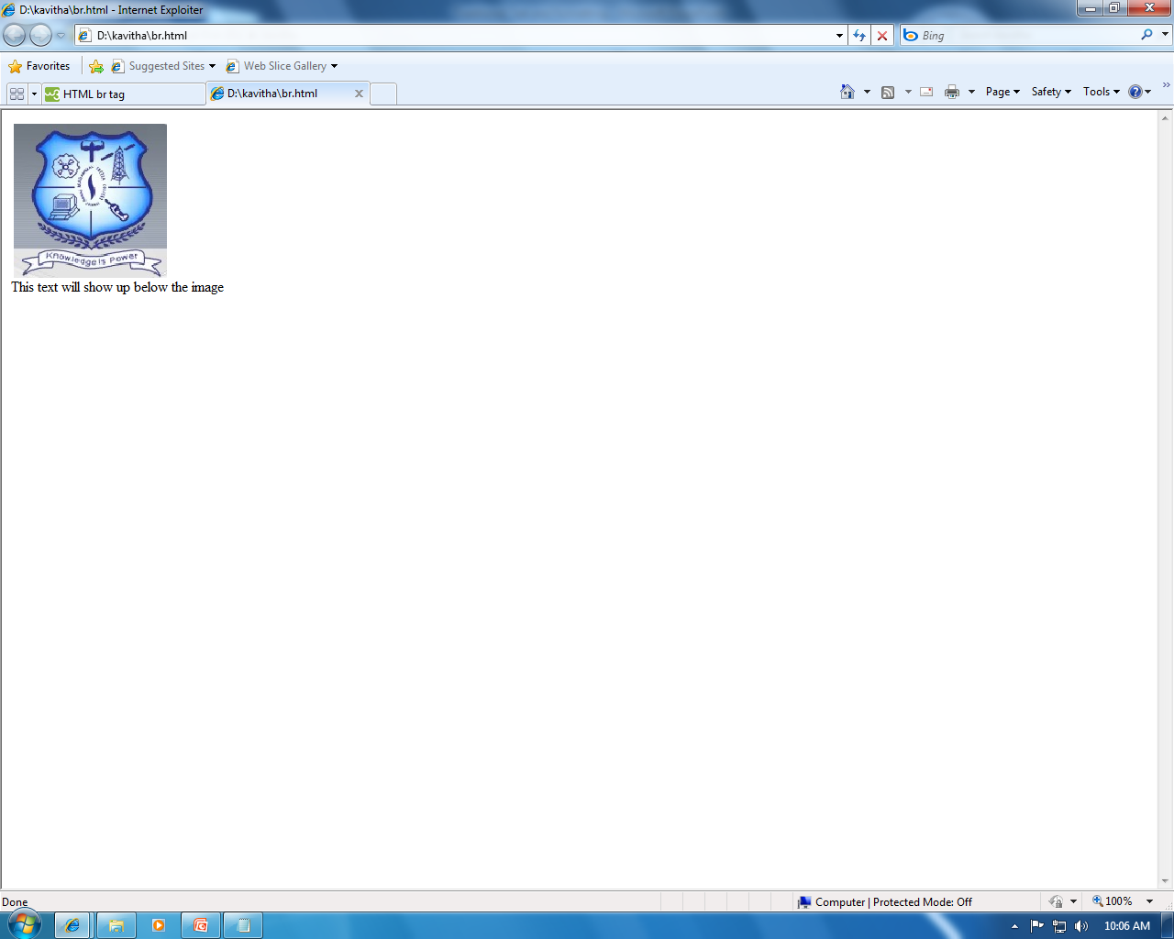
The BR Element
<img align="left" src="d:\kavitha\cl.jpg">
<BR clear="left">
This text will show up below the image

Slide 8
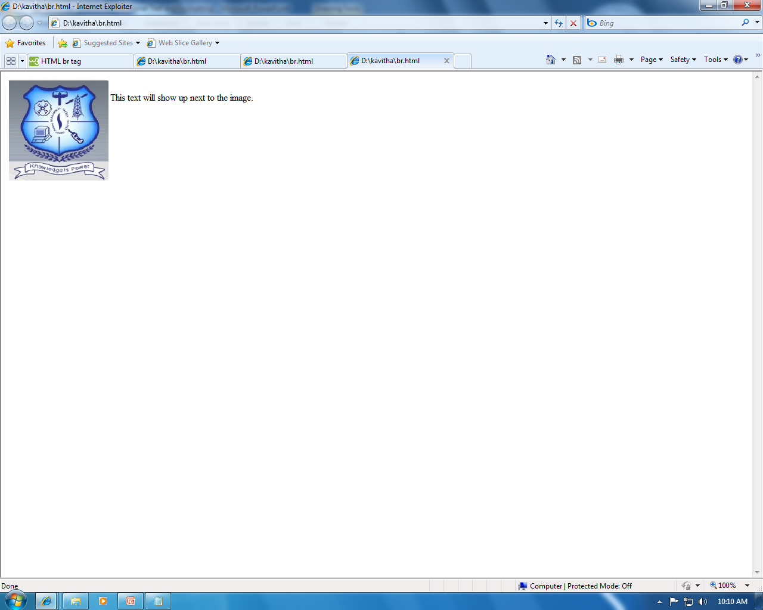
The BR Element
<img align="left" src="d:\kavitha\cl.jpg">
<BR clear=“none">
This text will show up next to the image.

Slide 9
The CENTER Element
The CENTER element causes all text between its start and end tags to be centered between the margins.
<CENTER> Text Goes Here. </CENTER>

Slide 10
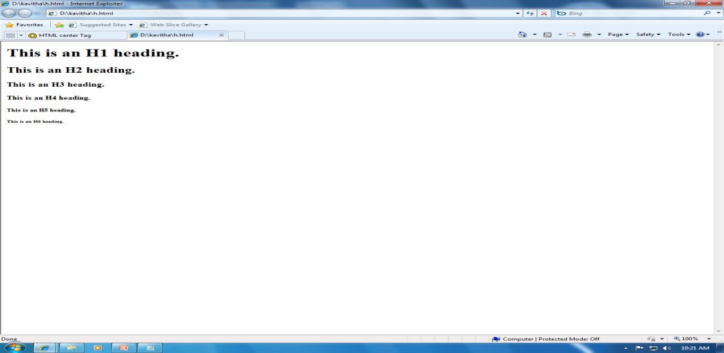
The HN Element
The highest level of heading is represented by <H1> tag, the lowest by the <H6> tag.
<H1> This is an H1 heading. </H1>
<H2> This is an H2 heading. </H2>
<H3> This is an H3 heading. </H3>
<H4> This is an H4 heading. </H4>
<H5> This is an H5 heading. </H5>
<H6> This is an H6 heading. </H6>

Slide 11
The HR Element
Horizontal rules are used to visually divide different segments of web pages from one another.
A simple horizontal rule is coded as follows:
<HR>

Slide 12
Lists
One of the most popular methods for organizing information is by using lists.
HTML presents three basic kinds of lists: unordered lists, ordered lists, and definition lists.
In unordered lists, the list items are marked with bullets.
In ordered lists, they are marked with numbers, Roman numerals, or letters.
Definition lists are a little different; they have a pair of values, one for the term, the other for its definition.

Slide 13
Unordered Lists
Unordered lists are specified with the <UL> tag.
Unordered lists are used when the order of the list items is unimportant.
The type attribute defines the type of bullets used to denote the individual list items.
The three options are: disc, circle and square.

Slide 14
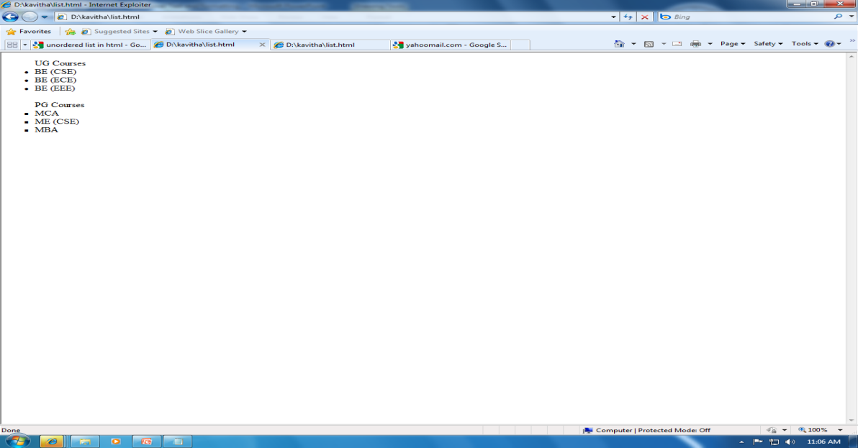
Unordered Lists
<UL type="disc">
<LH> UG Courses </LH>
<LI> BE (CSE) </LI>
<LI> BE (ECE) </LI>
<LI> BE (EEE) </LI>
</UL>
<UL type="square">
<LH> PG Courses </LH>
<LI> MCA </LI>
<LI> ME (CSE) </LI>
<LI> MBA </LI>
</UL>

Slide 15
Ordered Lists
Ordered lists are specified with the <OL> tag.
They are used when the order of the list item is significant.
OL elements have the type and start attributes.
The type attribute selects the kinds of numbering system utilized to order the list.

Slide 16
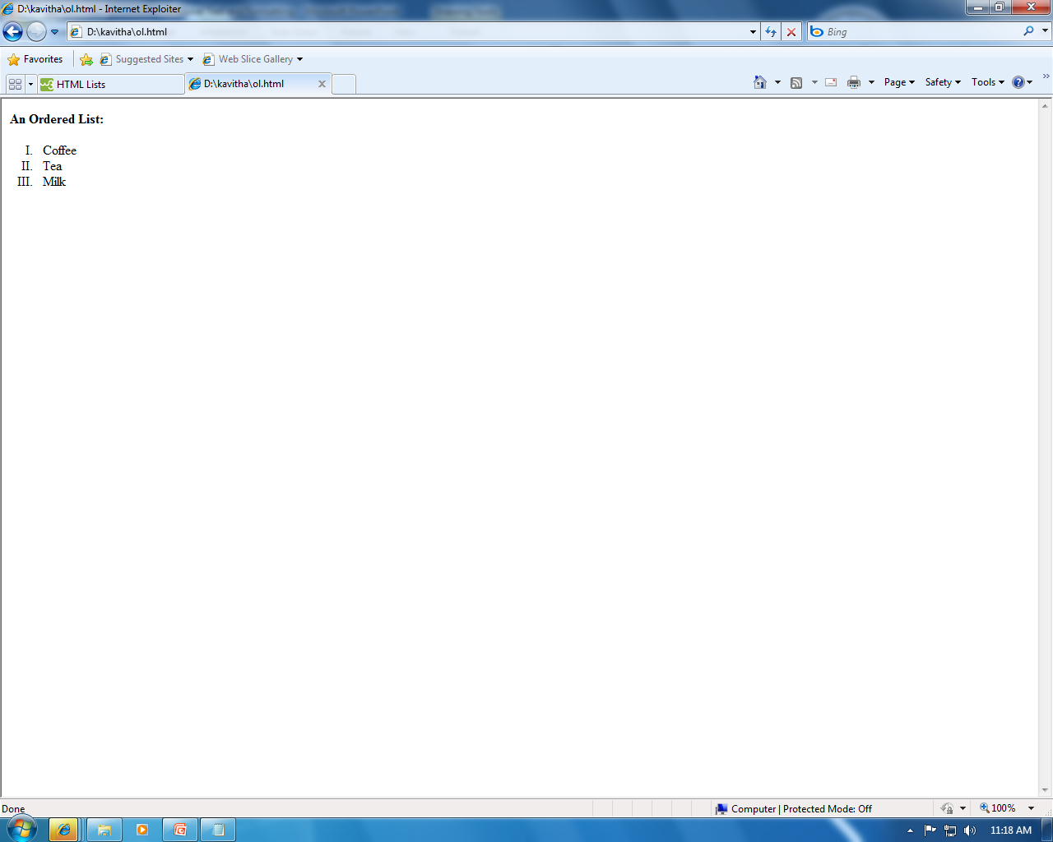
Ordered Lists
<html>
<body>
<h4>An Ordered List:</h4>
<ol type=I>
<li>Coffee</li>
<li>Tea</li>
<li>Milk</li>
</ol>
</body>
</html>

Slide 17
Definition Lists
Definition lists are specified with the <DL> tag.
Definition lists consist of pairs of values, the first being the term to be defined, and the second being the definition of the tem.
Example
<DL>
<DT> Satellite Dish
<DD> Antenna like device which functions to receive and concentrate television signals.

Slide 18
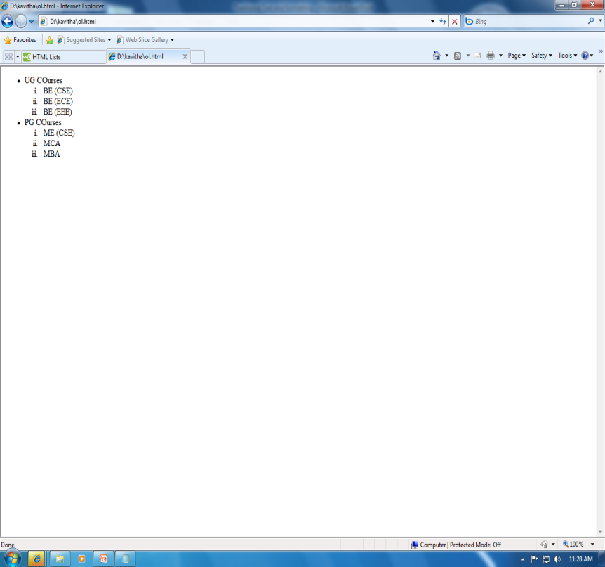
Nested Lists
Any kind of list – ordered, unordered or definition – can be nested within another list.
<UL type=disc>
<LI> UG COurses </LI>
<OL type=i>
<LI> BE (CSE) </LI>
<LI> BE (ECE) </LI>
<LI> BE (EEE) </LI>
</OL>
<LI> PG COurses </LI>
<OL type=i>
<LI> ME (CSE) </LI>
<LI> MCA </LI>
<LI> MBA </LI>
</OL>
</UL>

Slide 19
Text Styles
The B and STRONG Elements
Using the <B> and <STRONG> tags has the effect of rendering text in bold print.
The I and EM elements
Using the <I> and <EM> tags has the effect of rendering text in italicized print.
STRIKE and U Elements
The STRIKE element causes text to be struck through.
The U element underlines the affected text.
The BIG, SMALL, SUP and SUB elements
These four elements actually change the size or position of the affected text.

Slide 20
The FONT and BASEFONT Elements
The FONT and BASEFONT Elements perform the same task and use the same methods for doing so.
The difference between them is the scope of their effect.
Both set the size, color and font face for the text, but the basefont element is global for all body text in the document, whereas the FONT element is strictly local and affects only the text between its start and end tags.
Example
<BASEFONT size=4 color=“#000000” face=“arial”>
<P>
This is body text using the base font size.
<P>
<FONT size=+3> This is locally increased font. </FONT>

